Slide 1
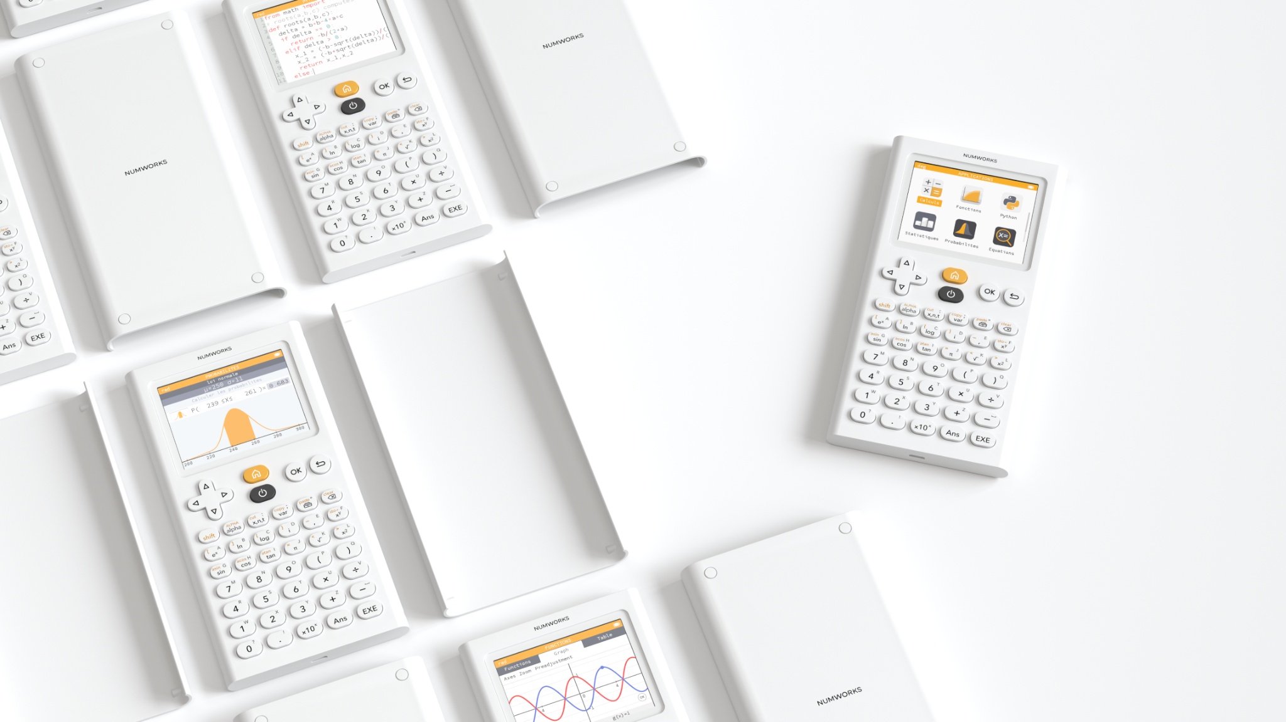
NumWorks
Bringing simplicity
into the classroom

Slide 2
Notes:
Think about your phone. Can you imagine using the phone you had 10 years ago? Absolutely not!
And yet, the graphing calculators in a lot of math classrooms have not changed in decades!
This is where NumWorks steps up. They wanted to give a fresh take on those devices we’ve used for years. Their goal was to create an intuitive device that brings simplicity into the classroom. The outcome? You can now spend less time teaching HOW to use the technology and focus your teaching on the actual mathematics!

Slide 3
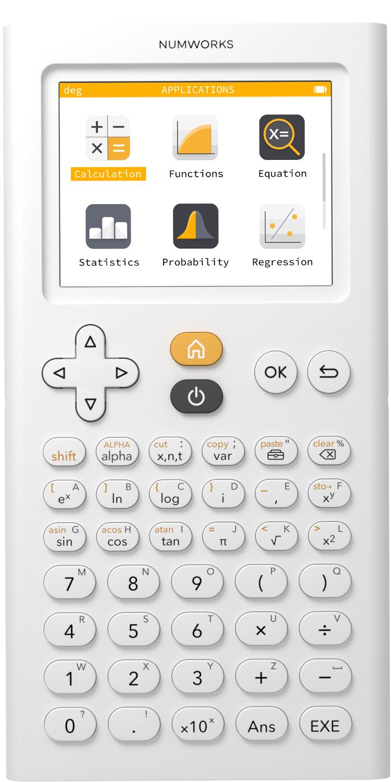
Keyboard design
Navigation Zone
Advanced Functions
Basic Functions
Notes:
If you take a closer look at the keyboard design, you’ll see it is arranged into three different zones.
At the bottom, we have our basic functions. Here you’ll find the number pad along with your basic operations like addition and subtraction. In the bottom right corner is the EXE which stands for execute.
Something you might notice is that there is no “negative” key. Instead, the minus key works as both subtraction and indicating a negative value. That means no more syntax errors for your students!
In the middle, we have our advanced functions which include commonly used operations and values, including trig, logarithms, square root, and pi. This zone also is home to the variables and toolbox keys which we will discuss further in a moment.
Shift is used for all the yellow keys, alpha is to write any alpha keys, x/n/t is a shortcut for those variables, var is where you can store things, the toolbox is the most important button, we also have a backspace button.
At the top, we have the navigation zone allowing us to select apps and options, return to the main screen and back out of menus.

Slide 4
App-based design
Notes:
The first difference you might notice between NumWorks and some other devices is our app-based design.
Students in today’s classrooms are from a technological world. Technology is used in all other aspects of their lives. However, often there is a divide between their real world and the math world. Outdated technology only makes the divide wider. By integrating devices that students are used to, students learn how to use the calculator quickly and feel they can engage in the mathematics.

Slide 5
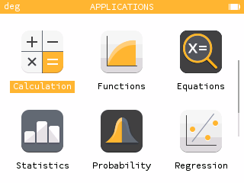
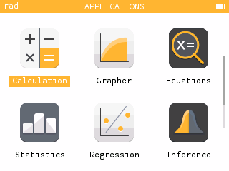
Calculation App
Notes:
I am going to switch over to the calculator using our free online simulator on our website.
www.numworks.com (Walk through how to get to emulator on website… works just like the calculator; cannot be touch screen)
Within the Calculation app, you can Perform a variety of computations
From the home screen, we can open the calculation app by clicking OK.
Let’s all start with a simple calculation. Let’s add ⅙ and ½. Our calculation is now viewable in the calculation history. Notice that we receive both the exact result in fraction form and the decimal approximation. If we evaluate 18 divided by 4, we again receive the fraction and decimal form but here our notation is different. Instead of using the “approximately equal to” symbol like in our first computation, here we have “exactly equal to”. Similarly, when we input sqrt80, we will see the exact simplified radical of 4sqrt5 and the decimal approximation.
This demonstrates two major features of the NumWorks graphing calculator. First, mathematical fidelity. We placed an emphasis on making sure our tool accurately represents the mathematics. ⅔ is approx equal to .667 but ½ is exactly equal to .5. Second, discoverability. You *could* use a function that’s hidden deep in a menu to convert between decimal and fractional form. A better tool would figure out automatically what is likely to be relevant to the user. This idea of “pushing” information to the user instead of them having to “pull it out” is a key benefit to using the NumWorks graphing calculator.
Do your students struggle with working with percentages? Well, with NumWorks, students can compute directly with a percentage. For example, let’s find 12% of 52 (12% (alpha backspace) * 52 = 6.24). What about finding the sale price of a $52 item that is 12% off? We can calculate 52-12%*52, but wait, NumWorks is intuitive so you really can just compute 52-12%. Navigate up for correct notation.
We want to push additional information that may be helpful without being distracting. In fact, we can obtain even more additional results in this computation. Did you notice that some of our two calculations have included an ellipsis at the end of the line? Let’s use the right arrow key to navigate over and click OK.
A window pops up with Additional results. The additional results for this calculation include the mixed number representation and the euclidean division! Using the Back key, we return to the calculator editor.
Additional results can be found for several types of computations. If we look at the additional results of any number, let's say 225, you will see its prime factors.
Now let’s take a look at evaluating a trig function. Your angle mode is indicated on the left side of the top banner. By default, our calculator is in Radian mode. We can easily change modes of our Calculator by back to the Home screen and going into Settings. You can navigate down and over to the Settings application or you can use the shortcut of pressing 9 twice to open it. You will notice that Angle measure is the first option and there you will choose Degree instead of Radian. I am going to keep my calculator in radians and let’s evaluate sine of pi/3.
Once again, we are provided with the exact and decimal approximation. Calculations involving trig will also provide additional results. Go ahead and take a look at those additional results….. The additional results include a graph of the unit circle as well as the cosine and sine values for that angle. This is information that wasn’t specifically asked for, but might be beneficial to the user!
Our Toolbox has a lot of additional functions organized by categories that you may want to use in your classroom. The toolbox can be opened using the Toolbox key which is directly below the OK button. Here you will see absolute value, nth root, log base a, probability, advanced trigonometry, and calculus features like derivatives and integrals to name a few.
Units are a very powerful tool found in the Toolbox on the NumWorks calculator. Commonly used units for all quantities are available. For example, for length, you’ll find inches, feet, yard, miles and more, along with the metric units.
You can work with units directly in a calculation so let's say we wanted compute 50 meters per second times 30 minutes. Let’s start by entering 50 meters. To do so, under “Units and constants”, we will choose length and then choose meters. Then navigate back to input your number of 50. Now we need to divide that by seconds, so in our toolbox, we can find seconds, or once you become more familiar with the calculator, you can just type the units instead. For the calculator to recognize a unit, we need to use the underscore button, so shift comma. For seconds, its abbreviation is s. To type letters, we use the alpha button and then 5 for “s”. Then to multiply by 30 minutes, arrow over times 30 underscore min (hold alpha 7, tan, 8) for minutes. We see that is 55.92 miles. If we take a look at the additional results, here we can see the metric unit, the imperial decomposition, and there are also reference points for your measurement. But let’s say we did not want miles and we wanted feet instead. To convert to a different unit, we use the arrow by typing shift x^y and we can then use our toolbox to find ft or type underscore ft and now we will see our answer is in feet.

Slide 6
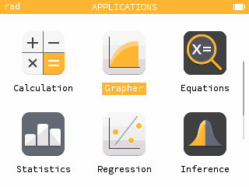
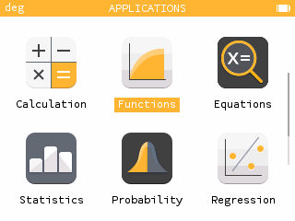
Notes:
We now head over to the Grapher app. With the Grapher app, you can plot the graph of functions, conics, inequalities and parametric and polar curves.
To plot a graph, we must first add an expression. Click ok to Add an element. You will see many templates here including the standard form of a line as well as parametric and polar curves, which you do not need to change the mode for. Let’s start with a function. Let’s graph the function f(x) = x^2 - 13. Let’s add another function. You will see this will change your function to another name, so g(x), but you can change that to any variable you would like. But let's just use g(x) = 3x + 4.
To view the graph of these functions, select Plot Graph.
Our Auto zoom was engineered to provide a display that best showcases interesting characteristics of a graph including the x-intercepts and extrema. You can adjust the window using the Axes menu. Press the UP arrow key to move to the menus and click OK on the axes.
We can trace a graph using the left and right arrow keys. Notice the x and f(x) OR g(x) values below the graph. Use the up or down key to move between the functions, depending on where you are. If we want to jump to a certain x-value, simply type the value and click enter. So let’s say we wanted x = 7, we will see that g(x) = 25 OR f(x) = 36. Because the - key zooms out, if you want a negative number, type the value first and then add the negative. For instance if we want to look at x = -5, we type 5 and then navigate over to add the negative.
The Calculate menu provides tools for finding points of interest including intersections, zeros and extremas. Let’s find the zeros of our quadratic function. You can navigate up and over to go to the Calculate menu. When more than one function is graphed, you’ll first select the function of interest, so therefore our quadratic. Now we select Find and zeros. No need to select left and round bounds! The Zeros are automatically found! Use the left and right keys to move between zeros. That works the same way for the min/max and intersections. A shortcut to get to your Calculate menu is to use the Toolbox button.
For calculus courses, you can show the value of the derivative and find lines tangent to the curve as well as computing integrals. To see the value of the derivative, head back to the Calculate menu. We can open the Calculate menu quickly by clicking the Toolbox key. Now toggle on the derivative value. Click the back key. Notice the derivative value at the bottom. To find the tangent line, open the Calculate menu and click Find Tangent or to find an integral, open the Calculate menu and click Find Integral and then enter your lower and upper bounds.
Take a look at the table tab by using the up arrow key to move to the tabs. The table tab shows values of f(x) and g(x) for given x values. We can set the interval for x by navigating up to “Set the interval”. Or type an x-value directly into the table. So if we want to see what f(x) and g(x) are when x = 100, simplify type 100 into the x-column of the table and we will see f(x) is 9987 and g(x) is 304. You can also add the value of the derivative by navigating to the f(x), clicking OK, and then turning on the derivative column. You will now see that column appear on your table.
Let’s head back to the Expressions tab and convert our two functions into inequalities. Let’s replace the equal sign in f(x) with strictly greater than using Shift x^2 to get >. For g(x), let’s make this less than or equal to by adding the < sign (shift sqrt) before the equal sign, which you can type or find in your Toolbox. Click ok. Head back to the graph tab. You will see the shading as well as the dashed/solid lines/curves.
One more time on the Expressions tab, let’s delete our two functions and take a quick look at a conic. From the templates, select the conic template. We can create different types of conics by deleting or adding things. For instance, I will delete a few things and add some to make my equation x^2 + (y-2)^2 = 9 and click OK, you will see it now says Circle as the legend. Let’s also add a line but we’ll do it in standard form! x+4y=8. Whenever you input an equation for a line or conic, select the three dots. Selecting Details will provide you additional information about your equation. In the details for a circle, we have the radius and the coordinate of the center of the circle and for a line, this will include the slope and y-intercept!
Also note that under the Functions options, this is where you can change your plot restriction and the color of your graph.

Slide 7
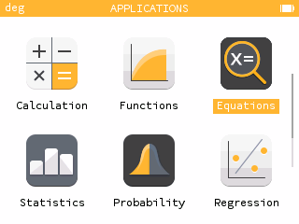
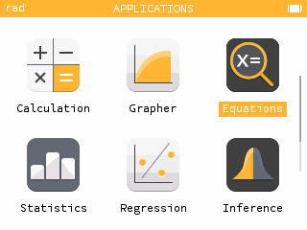
Notes:
We now head over to the Solver application. With the solver app, you can solve equations and systems of linear equations as well as financial interest problems.
Once you enter the Solver app, you will notice you can either open up Equations or our Financial solver.
The financial solver allows you to calculate simple and compound interest by choosing the parameter you want to solve and entering in the other information. But my focus today will be on the Equations part of the application.
Within the Equations app, to add an equation, click OK to open the equation templates. For this example, we’ll start from scratch and select Empty. Let’s solve the equation 3x - 7 = 23. To input type, 3x (x,n,t key) - 7 = (shift π) 23. To solve the equation, navigate down to “Solve the equation”. We see our solution is x = 10.
We can also solve systems of linear equations! Use the back key to return to our equation and clear the current equation using the backspace key. To add a system of equations, enter one equation at a time like before. This time I’ll use the x + y = 0 template and adjust it to 5x+3y = 7. Now add another equation. Let’s add -2x +y = -4. Let’s solve our system of equations. You will see the exact answer as well as decimal approximation. These values are copy and pastable. So we can copy our x-value by navigating to it and to copy, pressing shift var. Then go into Calculation app and paste it in there by typing shift toolbox or paste. You can use these answers to continue on with other calculations.
Finally, let’s explore solving a quadratic equation. For this example I will use the quadratic template but let’s change the +1 to -1. You will see your two simplified exact solutions and decimal approximations as well as the discriminant.
Now maybe you are sitting here thinking, wow this is too powerful at times for my students. In the home screen, if you scroll down to Settings and in Press-to-test, you can turn off various features, like the Equations solver, that you may feel are too powerful for a test or a quiz in your class. In order to exit Press-to-test mode, students would need to plug in their device to the computer. Our calculator is already approved for the SAT, ACT, AP, and IB exams and Press-to-test is not required. This is strictly for teachers to have more autonomy of what they want the calculator to do in their classrooms.

Slide 8
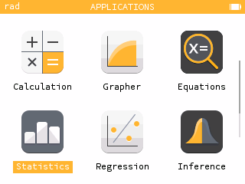
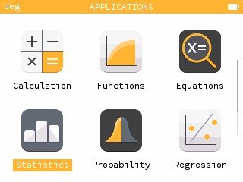
Notes:
There are three apps that apply to statistics and data analysis. Stats teachers will find all of these applications helpful but basic statistics and regression pops up in a lot of other classes as well.
The first application is simply called the statistics app. With the statistics app, you can study one variable data sets with graphical displays and summary statistics.
The first tab of the statistics app is where we enter our data. You will notice that you can enter up to three tables of data. Let’s add some quiz grades.
The first column is used to enter our values, in this case, our quiz grades. The second column is indicates the frequency of those values, or the number of students with a specific grade. My lowest quiz grade was 60. Notice the frequency is automatically 1. I had two students with a 75. I could enter 75 in two times, or change the frequency to 2. I had three students with an 81, 4 students scored an 89, 2 students a 92 and 2 student a 95.
Under the graph tab, we can view graphical displays of our data as a histogram, boxplot tab, cumulative frequencies, and normal probability plot. Let's choose a histogram.
Using the left and right arrow keys, we can obtain more information from the displays. Notice the frequency and relative frequency at the bottom of the screen. We can use the histogram settings to change the bin size. Let’s reorganize our data by letter grades. We’ll use a bin width of 10 and start at 60. Now we can see our frequencies within each letter grade.
Let’s now look at the boxplot by changing the type of graph we are looking at. The boxplot provides us with the 5-number summary and displays outliers if there are any. Use the left and right arrow keys to see each value.
The Stats tab provides all summary statistics for our data set and includes both the vocabulary term and the symbol. This is a great way to give your students exposure to new statistical concepts that they we recognize as they progress through their courses!
Back on the Data tab, we can add another dataset. For this dataset, we’ll use a formula. Navigate up to V2 and click OK. Select “Fill with a formula”. You can use one of the formula templates or use an Empty template. Let’s say we wanted to add 5 points to each quiz grade. To do so, I am going to choose an Empty template. We will take the values from V1 and add 5 (V2 = V1 + 5 ; so shift alpha / for a capital V 1 + 5). The frequencies will stay the same, N2 = N1 (shift alpha 8 1).
You will notice that the first table is red and the second table is blue. When two or more datasets are entered, you can compare the datasets using the graphical displays (again the red and the blue). The summary statistic comparisons can lead to great class discussions.

Slide 9
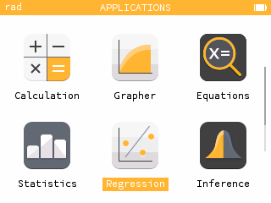
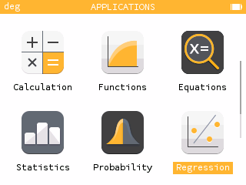
Notes:
To analyze the relationship between two quantitative variables, use the Regression app. With the regression app, you can display a scatterplot, plot a regression model, view a residual plot, and make predictions.
Just like with the statistics app, the first tab is where we enter our data. For X, let’s add 15,16,17, 21, 25, 32, 33, and 36. For Y let’s add 75, 72, 74, 64, 62, 50, 53, and 43.
Once your data is entered, navigate to the Graph tab to view the scatterplot. Scroll up to the Regression tab to turn on the regression you would like, so for instance, linear regression.
Using the navigation keys, you can move to each data point. If you hit the up and down arrow keys, you can move to the regression model and see the predicted output. So for instance our predicted y-value at x = 19, would be y-hat = 69.17. You will also notice the equation for the linear model is given.
Use the Toolbox key to jump back into the Regression menu. Here you can change your regression model, see your regression equation, correlation, create a residual plot, and can determine predicted values using the Regression menu. Let’s find what our predicted x-value will be when y = 60. We see that x = 25.53.
Again, the stats tab will display the relevant statistics for your data including the correlation coefficient.

Slide 10
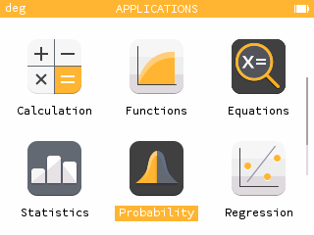
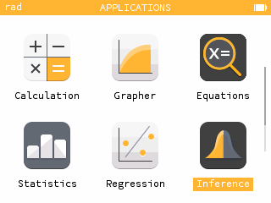
Notes:
The last statistic themed app is the Inference app. The Inference app actually contains three applications: Probability, Hypothesis Testing and Confidence Intervals.
Within the Probability app, you’ll see a list of several probability distributions. Let’s select the normal distribution.
Once a distribution has been selected, you’ll need to enter its relevant parameters. For the normal distribution, we need the mean and standard deviation.
Let’s use a mean of 128 and a standard deviation of 12. After selecting next, we’ll see a visual of our normal distribution as well as a probability statement. Let’s determine the probability that no more than 120. That is the probability that X is less than or equal to 120. We already have the value of X highlighted so we can simply press 120 and enter. Doing so, we get a probability of 0.25249. We also see the corresponding area shaded below.
We can also work backwards! What value of x lies at the 90th percentile? That is, what value of X has 90% of the area to its left? We can enter a probability in the right most box! (enter .90) and we will see that x is less than or equal to 143.3786.
So how would we do a probability of x greater than or equal to a value, or between two values? Great question! Navigate to the top left icon! Here we can change our probability statement. Let’s find the probability that x is between 100 and 140. We will see the probability is 0.8315.
In our Tests app, we can also perform hypothesis testing for means and proportions as well as chi-square tests. Let’s walk through a one-sample t test for a mean. We’ll select one mean. In most cases, we’d use a t-test for mean. First we enter our hypothesis. We can use the default values for this example. If you need to change the direction of the alternative hypothesis, just click OK. Next we enter the relevant statistics and the significance level. The calculated values are given. The final screen is my favorite. We have all the information from before plus a fantastic visual.
The Intervals app works in a similar fashion!

Slide 11
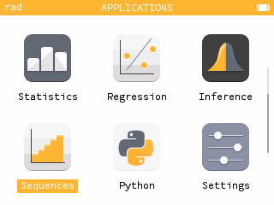
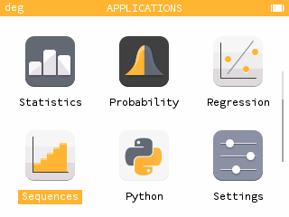
Notes:
The sequences app is where you can plot recursive and explicit sequences.
Let’s add a sequence by clicking OK. Here we see three types of sequences, an explicit expression, a recursive first order sequence, and a recursive second order sequence.
Let’s look at a recursive sequence. First we’ll type our recursive expression, then our first term. Let’s use un+1 = 0.75un + 150 and u0 = 200.
We can plot the sequence by clicking plot graph or using the graph tab.
Using the arrow keys, we can move along the sequence and see the value of each term.
We can also use the Calculate menu to find the sum of terms. Let’s find the sum of the first 5 terms. First we select the first term and then the last term. We can use the keys or just type the value. Hitting back, we can change that upper bound, lets try 100.
Similar to the grapher app, the Table tab shows the value of several terms. We can change the interval or type in values manually.
You can also change the first term you are starting with. Maybe your first term is starts at 1 and not at 0. So if you go back to the Sequences tab and navigate to u0, so can change that First term index to something else, like 1.

Slide 12
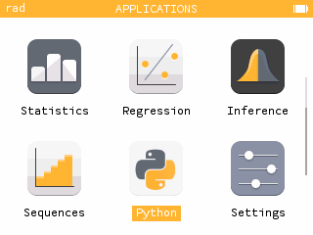
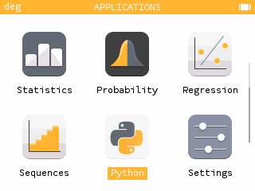
Notes:
The Python app is a very powerful features! Python is an industry standard programming language you can use in class. On the NumWorks graphing calculator, you can write and execute scripts.
Currently, your calculator will come with several scripts already loaded onto your calculator. Let’s take a look at the polynomial script.
Click OK on the name will open the script for editing. This is a great way to learn how to code simply by seeing what is already done!
For the polynomial script, we have a function called “roots” that take three inputs, a b and c. These are the coefficients of a quadratic polynomial.
From those inputs, we compute the determinant which is named delta in the code. Depending on the value of the determinant, the script will return different values corresponding to the roots of the polynomial.
Ok let’s run the script. Hitting the back button to return to the list of scripts, we move to the ellipsis. Select execute script. The code doesn’t run automatically, we need to call our function. Any relevant functions for the script will be found in the variables menu.
Let’s use inputs 2, 9, 7. We see our roots are -3.5 and -1.
You can write new scripts directly on the calculator or load them from your computer using the my.numworks.com

Slide 13
Online Emulator
numworks.com/simulator/
Notes:
The free online emulator is a great tool to use in the classroom. The free phone app is a great way for your students who might not be able to afford a calculator to be able to use the same device you are using in the classroom at home.

Slide 14
my.numworks.com
Notes:
If you go to my.numworks.com again there are other things you can do besides update your calculator.
(Give demo)
When you click on the dropdown on your name, you will see some other personalizations.
Simulator sessions (this is how you can access simulator sessions and how you can save them and reuse them/edit them).
Tutorials and SAT/ACT prep (show video of one SAT question).

Slide 15
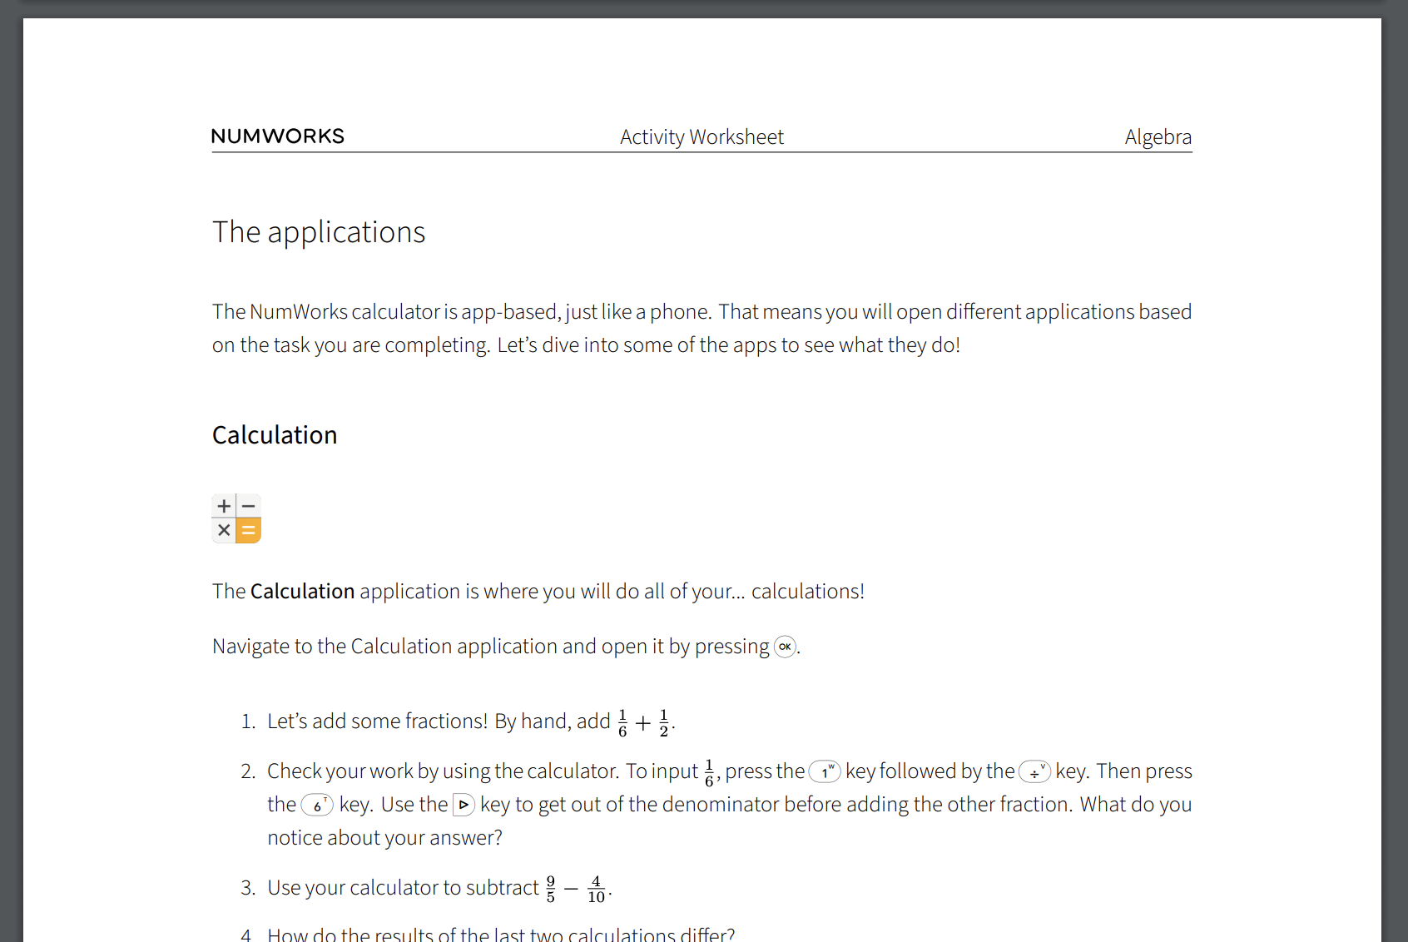
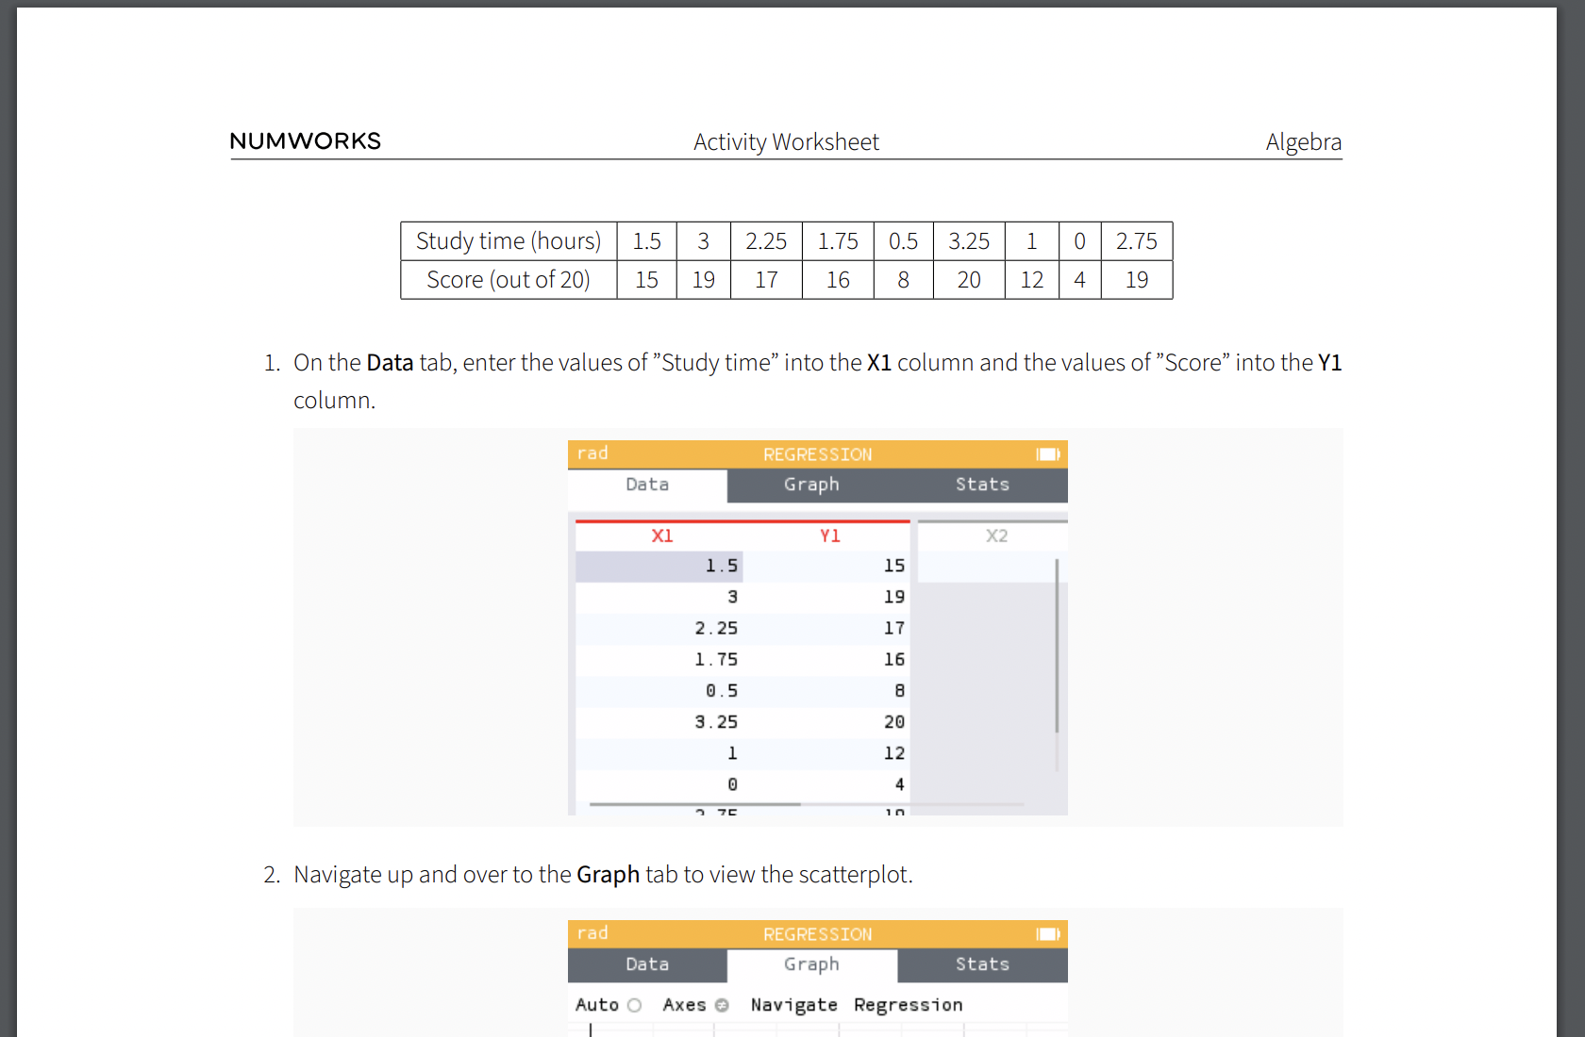
numworks.com/educators/activities/
Notes:
Lastly, there are classroom resources like this Getting started with NumWorks Algebra activity. Each activity has a teacher PDF with the answers as well as a student PDF. You can also show the solutions directly on the activity.
(Can give demo back on website showing these things)

Slide 16
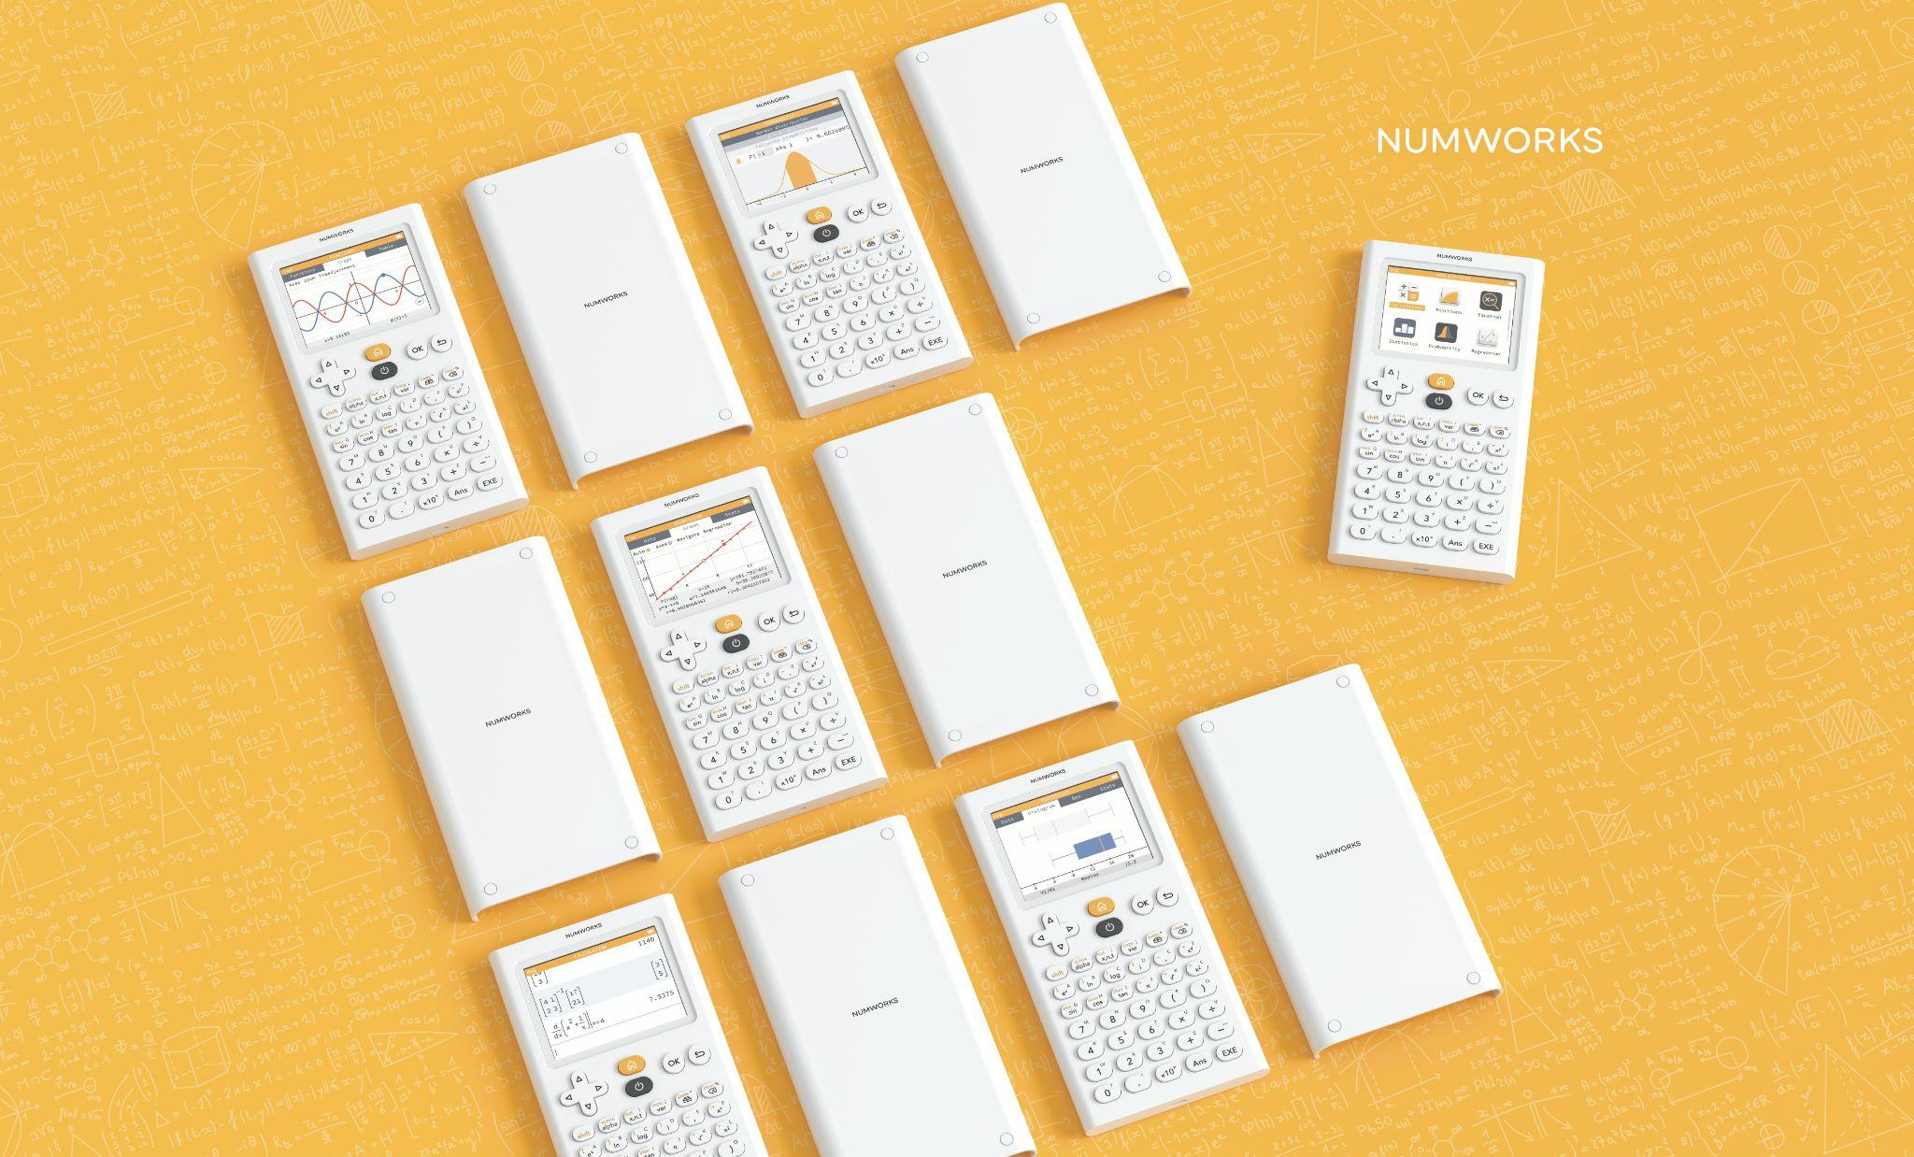
Thank you!
NumWorks Math Teachers:
Nick Koberstein
nick.koberstein@numworks.com
Kirstin Czerwiec
kirstin.czerwiec@numworks.com
Tracy Pratt
tracy.pratt@numworks.com
Notes:
Please do not hesitate to email if you have any questions!

